Slide 1

WELCOME

Slide 2
Presented By
Sarbani Dutta
Assistant teacher
Lamatashi Gps
Bahubal,Hobiganj

Slide 3




Todays Lesson
Class-Five
Lesson- 12
Punctuation Review
Part-A,A1

Slide 4
Learning outcomes
By the end of the lesson student will be able to
listen the lesson attentively.
say and write the uses of capital letters,full stop,cursive letters and question mark.
rewrite sentences by using cursive letters and punctuation marks.

Slide 5






Now we see some pictures

Slide 6
Lets enjoy a video

Slide 7
Today we read
Punctuation Review

Slide 8
Use of capital letter
Capital letter
A,B,C,D,E

Slide 9
Use of capital letters
Every sentence begins with a capital letter.
This is mina.
I am a student.
I read in class five.
Dhaka is the capital of bangladesh.

Slide 10
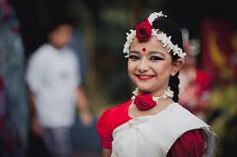
Use of capital letters
The name of a person
Begins with a capital letter.
I am ili.
L
L
ili read in class five.
Lili

Slide 11

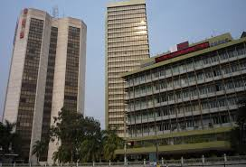
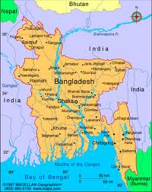
Use of capital letters
D
haka is the capital of angladesh.
The name of a place or a country begins with a capital letter.
angladesh is our motherland.
B
B
B
Dhaka
angladesh

Slide 12
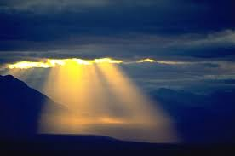

Use of full stop
A sentence that gives a statement
A sentence that tells something
The sun gives us light
.
.
A read Rose

Slide 13
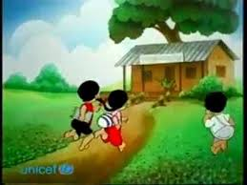
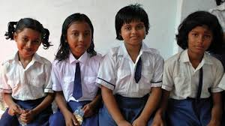
Use of full stop
A sentence that gives a mild command ends with a full stop(.)
Every day go school.
Keep quite.

Slide 14
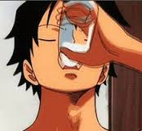
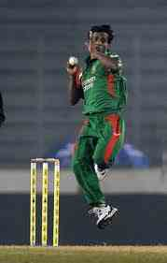
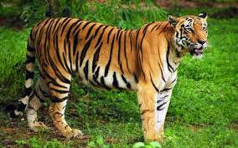
Use of question mark
A sentence that asks something ends with a question mark
What is the name of our national animal?
Do you want to play cricket?
Are u like to drink milk?

Slide 15
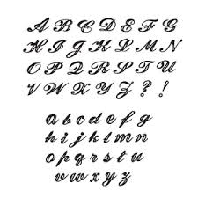

Now we know about Cursive letters
These are cursive letters.

Slide 16
Silent Reading
Open your book page 43.
Read A,A1

Slide 17

Group work
Group-A
Group-B
Tell the uses of capital letter
and full stop.
Tell the uses of cursive letter
and question marks.

Slide 18

Pair work
Rewrite the sentences form your book page no-43.(A1)

Slide 19
Individual work
1.raju is a firefighter
2.the sky is blue
3.what is your name
4.what time is it
5.always speak the truth
Rewrite the following sentences by using cursive letters(a),add capital(A) letter,full stop(.) and questions mark(?)

Slide 20
Corrections
1.Raju is a firefighter.
2.The sky is blue.
3.What is your name?
4.What time is it?
5.Always speak the truth.

Slide 21

THANKS

